Slide 1
Rural Extension with Africa’s Poor
A Christian approach to development through teaching

Slide 2
REAP’s Natural Medicine Story
Notes:
Reap is a Christian charity set up to improve the lives of Africa’s poor through demonstrative teaching, and growing natural medicines is one of REAP’s stories.

Slide 3
Rural Extension with Africa’s Poor
REAP is a Christian charity set up to improve the lives of Africa’s poor through teaching
REAP UK
Registered Charity No. 1075121
Notes:
REAP’s approach is biblically based; it is concerned for the wellbeing and dignity of the individual as well as the whole of creation, and believes that good stewardship of God-given resources will enable the poor to improve their standard of living.
REAP instructs the poor by direct group and personal teaching, with demonstrations.
In this way REAP specifically seeks to overcome a culture of dependency and the call for large external resources, so to reverse the detrimental effects of materialism and environmental neglect.

Slide 4
Natural Medicines
Agriculture Reuse of waste products
Domestic skills Efficient use of fuel
HIV/AIDS Clean water Soil conservation
Animal husbandry Hygiene
Notes:
Natural Medicines are just one of many ways that REAP brings development through teaching

Slide 5
How REAP’s Natural Medicine program works
REAP finds ways to improve the lives of Africa’s rural poor
REAP refines simple methods of teaching
REAP shares relevant teaching with the poor
REAP ensures that it’s teaching has become sustainable
Notes:
REAP works with the poor to discover ways to improve their lives. With natural medicines that requires discovering plants and methods which will medically benefit families and can be sourced in their locality.
REAP produces appropriate methods of teaching to demonstrate how to use medicinal plants at home, also supplying some initial plants to start these gardens. It is important that the recipients are aware of precisely how the plants can best be grown, for what purpose they should be used and what dosage needs to be given, so clear instruction and understanding is vital.
REAP shares with the poor directly. Often this is through a network of local churches. Sometimes REAP will hold workshops for a specific people group. Many people become aware of REAP’s natural medicine program through agricultural show stands, organisations that have benefited or simply through word of mouth from a community that has taken REAP’s teaching on board. An increasing number of people now hear about REAP via the internet (either through our own website or that of Anamed).
REAP follows up and reviews their teaching to ensure that the methods are successfully used. The
feedback on how natural medicines are applied enables REAP to refine, extend and improve its teaching.

Slide 6
ANAMED Action for NAtural MEDicines http://www.anamed.org
Anamed and REAP have formed a useful partnership
Notes:
REAP and Anamed have come to work closely together in the realm of natural medicines.
Anamed is an organisation that has done a great deal of research into the use of natural medicines and is a source of much of REAP’s Natural Medicine teaching. In turn Anamed has benefited from REAP’s experience and practical feedback.

Slide 7
REAP and Anamed share objectives
To combine the benefits of modern scientific knowledge with those of traditional herbal medicines
To seek to keep to a minimum the negative aspects of each
Notes:
REAP and Anamed seek to combine modern scientific knowledge with traditional practices to use the best of both worlds. Scientific understanding provides information on hygienic preparation, dosages, limitations and side effects, whereas locally grown plants offer easy access at little cost.
Negative aspects of both are overcome by providing knowledge free from commercial exploitation and manipulative purposes.

Slide 8
Spreading ideas through local churches
A vast network with many outlets
Reach remotest areas
Ideal channel for teaching
Provides a motivation for wellbeing
Notes:
REAP has found that local churches provide an ideal channel for their teaching on natural medicines.
This is because;
There are an enormous number of churches in Africa
Churches are in every part of the continent and in even the remotest areas
Churches are set up as institutions for teaching and have authority within the local community
Motivation for wellbeing and healing is consistent with the gospel of Christ

Slide 9
Church concerns about traditional healers
‘Unhelpful spirits’
- no rituals
Fear
-explanations offered
Power relationships
-information shared freely
Exploitation
-teaching background understood
Notes:
At first many churches expressed concern at using methods that had been associated with traditional healers.
REAP has run workshops to explore the background to these reasons and have sought to counter each of these concerns.
Churches have associated many natural medicines with unhelpful spirits
REAP’s teaching is free from any kind of ritual
Fear and superstition are often combined with traditional medicine as it appears magical
REAP offers scientific explanations with every remedy
Relationships of power and control often emerge from witchdoctors and traditional healers
REAP shares its information freely and encourages the spread of knowledge to others
People have been exploited because of limited reasoning behind traditional medicines
REAP explains the background of natural cures so that everyone is free to benefit without guilt

Slide 10
Uses of the pawpaw
Notes:
Pawpaw seeds were one of the first natural medicines that REAP taught about.
The plants are already grown extensively for their fruit.
Pawpaw seeds cure intestinal worms.
The latex-laden skin of unripe pawpaw is also helpful in aiding the healing of infected wounds.
The fruit itself is not only very nutritious; it aids digestion and is a mild laxative. Secondary uses can be for amoebic dysentery and asthma.
Pawpaw can also be used as a meat tenderiser.

Slide 11
Maize
Notes:
Hairs from maize are effective in curing urinary infections.
Maize hairs contain the alkaloid allantoin whose anodyne (pain soothing) action with bladder infections is well proven.
The recommendation is to take 25 grams of dried maize hairs and boil it in 1 litre of water for five minutes.
This should then be drunk throughout the day.

Slide 12
Roselle (hibiscus sabdariffa)
Notes:
Roselle produces flower calyces that can be made into a refreshing herbal tea.
This has has long been a popular drink in Sudan and Egypt.
REAP director Dr. Roger Sharland introduced Roselle into Nyanza in Kenya when he noticed it grew well in similar hot sunny conditions in Sudan.
Roger then discovered on the internet that roselle is a diuretic so is useful in treating urinary infections and for high blood pressure.
It also brings relaxation and stimulates the immune system.
REAP worker Sam has encouraged its growth and shared the new plant with others, which has since become extremely popular throughout his area.

Slide 13
Groundnut shell charcoal
Notes:
Groundnut shell charcoal is useful for mild food poisoning and diarrhoea.
Dried shells of groundnuts need to be roasted in a covered pan, after five minutes they should be left uncovered and roasted further until black.
These are then crushed so the powder can be administered.
The blacked groundnut shells work by attracting excess intestinal gas to the surface of the charcoal, so as it is ingested it brings relief.

Slide 14
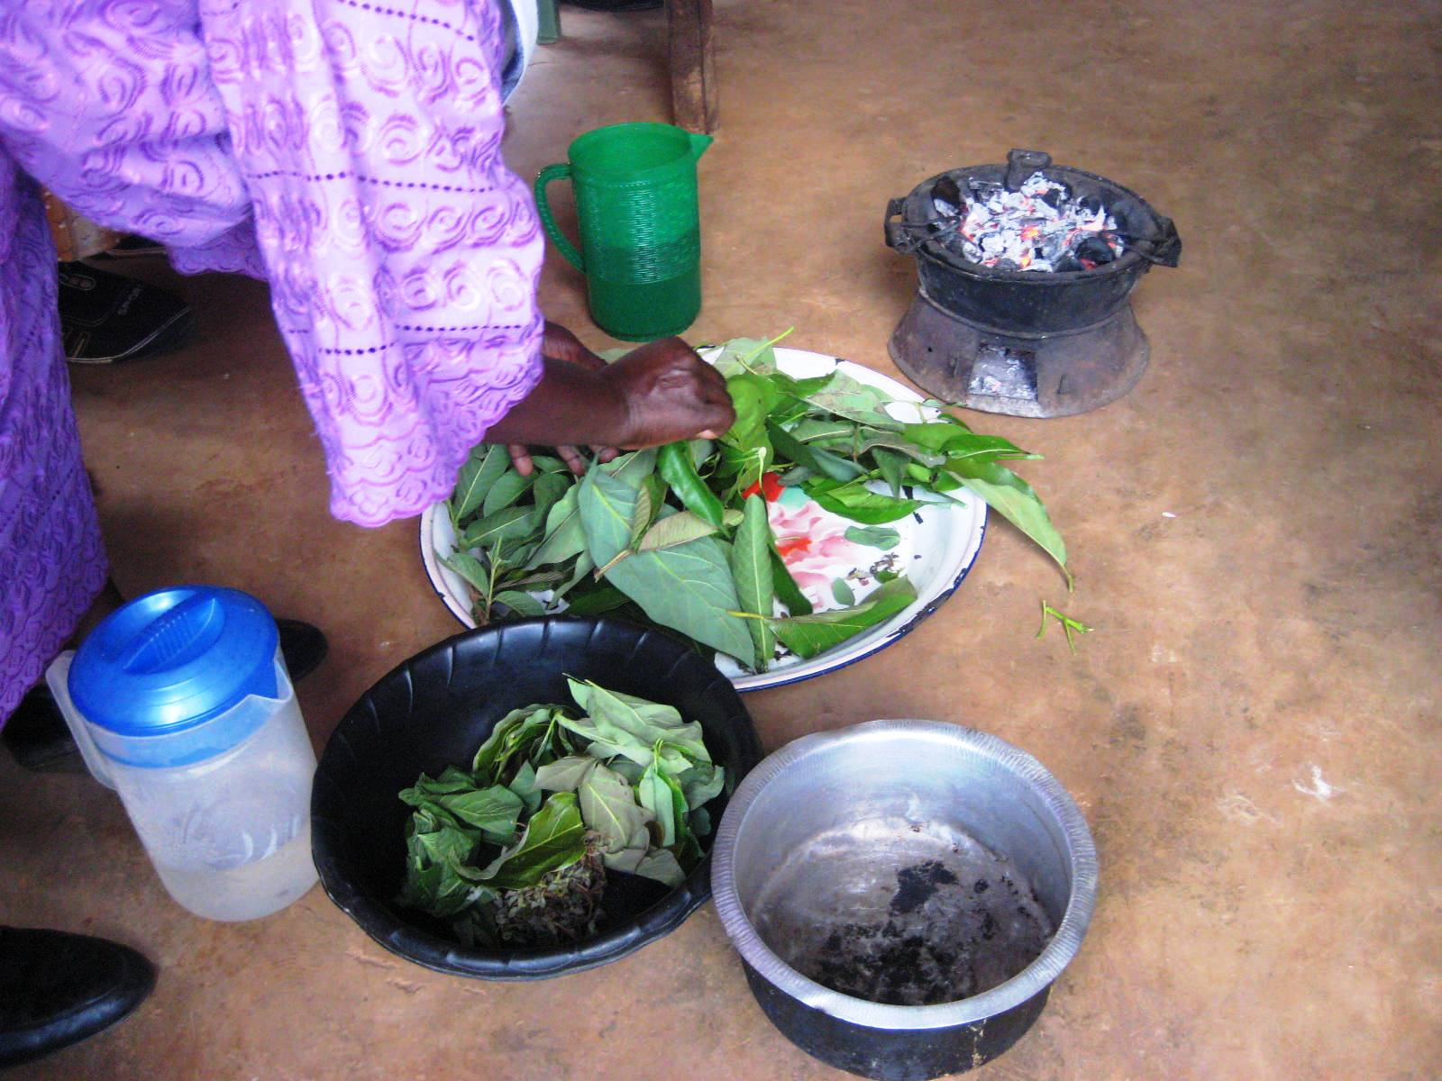
Young leaves of guava, avocado and mango
Notes:
The fresh new leaves of guava, avocado and mango trees all contain tannins and are a very effective treatment for diarrhoea when given as a tea in conjunction with oral rehydration solution.
This photo shows a demonstration how to make Amoeba tea from guava, avocado and mango leaves with Euphorbia hirta (or Asthma Weed).

Slide 15
Asthma Weed (Euphorbia hirta)
Notes:
As its name implies, Asthma weed helps in controlling asthma as well as being useful in combating amoebic dysentery when made into a tea with pawpaw, mango and guava leaves.

Slide 16
Guava tree
Notes:
The guava tree is recommended to be grown by REAP as its fruit contains a high amount of vitamin C to prevent and treat scurvy.
Although not as effective as the pawpaw, the leaves can also aid the healing of wounds.
Well known throughout Africa, guava trees can be grown within a hedge or alongside other crops so don’t take up valuable space.

Slide 17
Ringworm bush (cassia alata)
Notes:
The ringworm bush is not only an effective cure for ringworm, it is also very useful in combating fungal infections of all types.

Slide 18
Moringa leaves
Notes:
Moringa is a tree with a taproot that goes deeply into the soil so it has the advantage of being able to be grown in small gardens without much determent to the other crops.
There are two varieties, both provide leaves that are used the same way;
Moringa stenopetala is native to Africa and is the larger variety,
Moringa oleifera is a smaller tree from Asia and can more easily be grown as a hedge pruned to stay at a convenient size.
In the 1980s the organisation ECHO promoted the use of Moringa’s highly nutritious leaves as a vegetable, as it was available during the early rains and into the dry season when there were often no other crops.

Slide 19
Moringa powder
Notes:
Tearfund later ran an article in Footsteps about the use of Moringa leaves when dried and ground into a powder. REAP incorporated this into their teaching.
Moringa powder can be easily added to any meal (and is particularly complementary to meals high in carbohydrates).
It is especially useful for HIV/AIDS patients, malnourished children and anaemic people.
Moringa leaves contain 7 times the Vitamin C of oranges, 4 times the Calcium of milk, 4 times the Vitamin A of carrots, 3 times the Potassium of bananas and twice the protein of milk so are extremely valuable.
For further information on its nutritional use http://www.echo.net

Slide 20
Moringa seeds
Notes:
Other uses of Moringa are for diarrhoea, diabetes and skin infections.
The seeds of the Moringa tree have a cleansing effect on muddy water.

Slide 21
Garlic
Notes:
Garlic has traditionally been used by many nations both for its flavour and its medicinal properties.
REAP recommends its use against infections such as boils, coughs, colds and fungal infections.
It can also be used for controlling blood pressure, diabetes and amoebic dysentery.

Slide 22
Ginger
Notes:
Ginger is also frequently grown in Africa for flavouring.
The part of the plant that is used is called a rhizome (the knobbly bit).
It is useful for nausea (especially travel sickness) and as an ingredient of cough mixture.
When mixed with a vegetable oil ginger offers much relief when used as a rub for rheumatism.

Slide 23
Frangipani
Notes:
Frangipani is a medium sized tree that is extremely decretive and provides shade so is often grown close to the house.
The sap from the opening flowers is useful in the cure of herpes zoster (shingles), which particularly inflicts AIDS patients.

Slide 24
Passion friut
Notes:
The passion fruit plant is easy to grow and can be planted within hedges so takes up no extra space. Passion fruit has a calming effect that will help with sleeplessness and asthma.

Slide 25
Artemisia annua
Notes:
Artemisia annua is a bushy plant that can be grown most successfully from cuttings.
Artemisinin is the ingredient of Artemisia that is now used internationally as the drug of choice for malaria.
The plant contains many additional ingredients (not used by the pharmaceutical companies) that also aid recovery from malaria.
The leaves are dried and made into a tea.
This method has the advantage of decreasing the risk of developing resistance to the drug.
Dosage is straightforward and so it is easy to use responsibly.
Immediate treatment reduces the risk of complications.

Slide 26
Growing artemisia
Notes:
Just a few plants will be sufficient to keep a large family free of malaria.
In hotter regions it is difficult to grow without good husbandry techniques, for example the plants benefit from a microclimate created when surrounded by banana trees.
REAP adapts its teaching to suit each appropriate area.

Slide 27
Other Artemisia benefits
Notes:
The Artemisia plant is very aromatic so confuses pests that seek out their hosts by smell, so is a useful addition in a home vegetable garden.
It also has a very positive effect on the body’s general immunity; it can be made into an ointment and a wash for eye infections.

Slide 28
Lemongrass (Cymbopogon citratus)
Notes:
Lemongrass also repels insects.
It is particularly beneficial when used as a boarder plant because the deep roots prevent the run off of soil during the rains.
Lemongrass leaves can also be made into a refreshing tea and have the extra benefit of helping to bring down a high fever.
It is recommended to be used for bronchitis and bad breath.

Slide 29
Neem tree
Notes:
The Neem tree is extremely useful, but crops cannot be successfully grown alongside Neem trees.
It is a wonderful pesticide.
REAP teaches that it is best grown in a compound that requires shade from a large tree, for example close to a house or in open land by a church.
In this way church meetings can benefit from being relatively insect free and the congregation are able to take home some of the precious leaves for their own use.
Neem is recommended for lice, scabies, athlete’s foot and other skin problems.
It also aids the reduction of fever and is used as a toothbrush.

Slide 30
Black stones
Notes:
Dr Roger Sharland first learnt about using a black stone to draw out poison from snake bites or scorpion stings from the Congo.
When cow bones are burnt without air, in the same way as charcoal is made, the small internal capillaries are opened so that they will suck fluids outwards when pressed against the bite.

Slide 31
Notes:
When Roger read about black stones in the then Oxfam publication ‘Baobab’ he thought it sounded interesting but found Oxfam’s way of baking goat bones in a cocoa tin a bit complicated.
It was when REAP started interacting with Anamed that they started using baking foil and found it easy to make, then refined the teaching through practice.
One thing that REAP has discovered was the importance of smell in determining when it is ready.

Slide 32
Chilli ointment
Notes:
Chilli peppers are easy to grow. When dried and pounded, their active substance ‘capsaicine’, can be mixed with vegetable oil, some beeswax or candles, and is useful as a heat rub for rheumatism, arthritis or joint and muscle pain after hard work, such as on the farm.
Capsaicine can also be used as an insecticide if the chilli is soaked in cold water and filtered through a cloth, the fluid can then be sprayed onto plant leaves to keep pests away.

Slide 33
Aloe vera
Notes:
The sap from Aloe vera plants has been well known in many cultures for its use in healing burns.
Having an Aloe vera plant growing by the kitchen for treatment of burns is particularly helpful in Africa where an open fire is commonly used for cooking and heat.

Slide 34
Using the sap
Notes:
Roger’s Korean neighbours (in Nairobi) used Aloe vera a lot and taught him which plants released the most amount of gel and also shared how they used it in Korea.
As well as burns it is useful as a local antiseptic for wounds and conjunctivitis.
Aloe vera can also be used as a laxative and for intestinal worms.

Slide 35
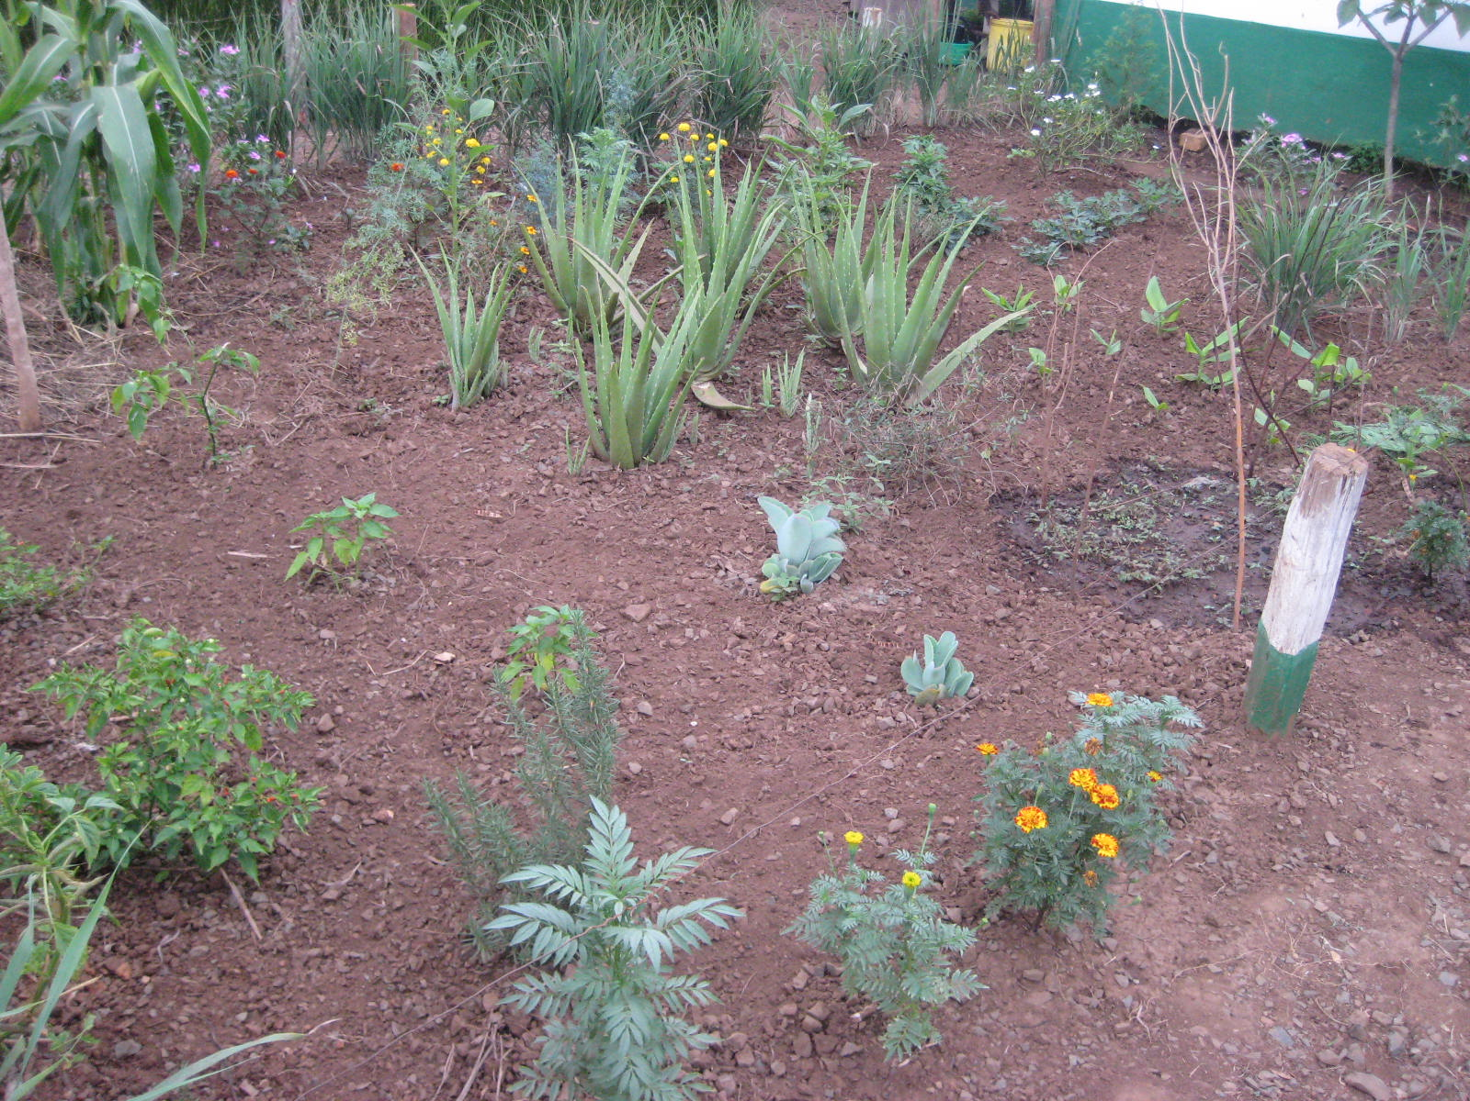
Medicinal gardens for everyone
Notes:
REAP aims to teach the rural poor within their communities that even with only a very small plot of ground they are able to grow their own natural medicines.
In this way medicines can be immediately available.
Wounds and burns, in particular, heal much quicker when treated without any delay and are less likely to become infected.

Slide 36
REAP worker George in his garden
Notes:
The poor often spend much of their income on health related concerns.
This is made worse by the fact that, because of the cost, they leave it too late to seek treatment and this ends up even more expensive.
If they have natural medicines at home treatment can be used before the condition gets serious, and manufactured medicines don’t have to be purchased.
Cash will then be available for use in school fees, uniforms and the purchase of other items frequently beyond their reach.

Slide 37
Planting a medicinal garden
Notes:
REAP is in need of more skilled personnel to teach the advantages of traditional medicines and give reliable instruction on the planting and use of gardens.
Everywhere REAP spreads this message it has been overwhelmed with requests for further teaching.

Slide 38
Church medicinal gardens
Notes:
Many churches have now planted medicinal gardens close to their churches, for both teaching purposes and to provide plants for their congregations.
There are lots more African church communities that could take this message forward if REAP could afford to employ trained staff to instruct the church leaders.

Slide 39
Notes:
REAP is constantly experimenting with new varieties of plants and their suitability for different regions and climates.
By closely monitoring the success of these, REAP can modify their teaching methods to suit everyone’s needs.

Slide 40
REAP’s garden at Kisumu Show
Notes:
REAP has an exhibition garden at the Kisumu Showground which is used all year for training and demonstration purposes.
Further land in Kisumu helps to produce many plants for people to begin their own medicinal gardens.

Slide 41
REAP UK - supports work of REAP in Africa
Registered Charity 1075121
REAP
18 Yewhurst Close
Twyford
RG10 9PW
REAP@ukonline.co.uk

Slide 42
Ways to support REAP:
Financial – please fill in form if you are a taxpayer for claiming Gift Aid
Prayer – please provide e-mail/mailing address to receive our Newsletters
Advertise REAP – let us know if you could show presentations or DVDs
Notes:
There are several ways in which you can help REAP.

Slide 43
Visit our Website:
http://www.reap-eastafrica.org
Notes:
Please visit our website for more information.

Slide 44
Rural Extension with Africa’s Poor
A Christian approach to development through teaching

